Slide 1








Coca-Cola Current Relationship in BI Space
Our Focus
Marketing
Innovation
HR
PLM
Finance
Customer
Sales
Quality
Supply Chain
Promotions
Compliance
Technology
SA
SA
SA
SA
Consolidation & Reporting
. Development . Support – Platform
Support
Support for all strategic applications in SAP, SFDC, Promax and others
Our Work
Reporting & Dashboards
. Development . Support – Platform, L3
Integration, Analytics & Dashboards
.Development . Deployment . Support
Development and Support
CONA Build/ Deployment & Production Support
Our Output
Completing 200+ projects in MSBI, BO, Microstrategy, Talend, Google Big Query
Migrating 80+ applications to Cloud
Global implementations of Compass
Multiple dashboards deployment across TCCC on mobile devices
Implementing use of Rapid Design Visualization on dashboarding projects
Support
Compass (MSBI), BOBJ Platform upgrade
MSBI, BO L3 Application Support
Completing 200+ projects in SAP BI, BODS, Teradata, BOBJ, Microstrategy & Tableau
Key Programs: Financial DWH– consolidated reporting, Freestyle vendor managed supply, Coupon campaign management system, Fleet management dashboard, HR Dashboard
Platform Upgrade: BO Data Services, SAP BW Release 7.3, Business Objects 4.0
Support
BO Data Services landscape upgrade
SAP BW Release 7.3 upgrade
Business Objects 4.0 upgrade
Non SAP L3 Application Support
SA
Development
Tableau Factory
Sales Incentive
SA
Development and Support
Mobile Fact book – Europen & Global
Nielsen
Macro Economics
SA
Development
Hyperion Planning & Consolidation
NSR Compass Picasso CCNA Clarity QSE FDW WCPPT Freestyle Regional Sales MinuteMaid CONA
Key Programs
MSBI Informatica Spark Azure Hyperion Teradata BODS SAP BW BOBJ Tableau Microstrategy AWS Nifi
Tools
(Currently) USA India Argentina Belgium Spain Australia UK
Our Location
Reusability Standardization RDV Innovation Automation
Our Value Add

Slide 2
NSR- The Coca-Cola team (TCCC) required a Reporting\Analytics platform for near-Realtime Reporting after consolidation of Sales Revenue data from all Bottlers
BUSINESS / DATA CHALLENGES
SOLUTION
BENEFITS
Develop an Analytics Platform that caters to BU requirements across the globe
Different BUs are at different levels of standardization and need a standards based approach for faster adoption
Merge bottler information with internal details, develop insights about consumers and customers to generate value for both the corporation and the bottlers
Enable a subscription based model to reduce the TCO for each unit
Product based approach to drive standardization
Tool kit to assess and onboard new bottlers across the globe
Fine grained security to ensure right access for the right user
Agile based development with 2 week sprints
Integration of bottler data with internal data
Azure cloud based solution to support flexible subscriptions
Big Data based data lake to support scalability
Cosmos DB and Azure SQL to support geo-distribution
Informatica BDE based standardized data processing
AAS – PowerBI based fine grained metrics to enable self-service
Java based data steward application
Rapid development of the product in 90 days
90 day plan for onboarding all bottlers
Cloud based subscription option
Option for bottlers to provide data in standard form or bottler specific form
A platform that can provide consumer and customer insights by integrating revenue and volume information
Internal Capgemini & Microsoft Confidential

Slide 3
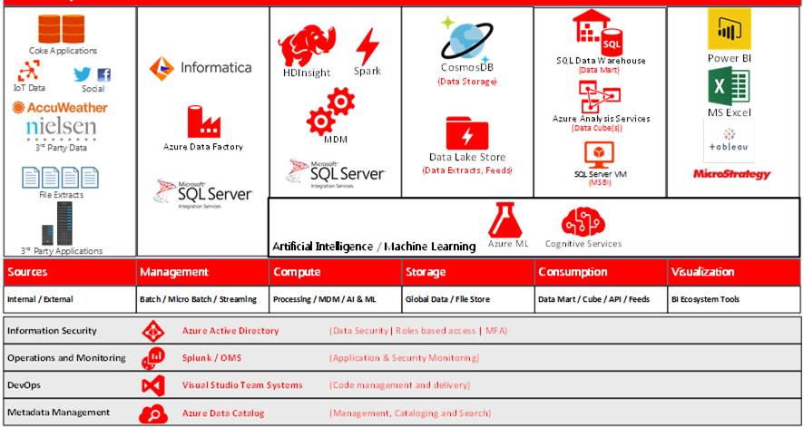
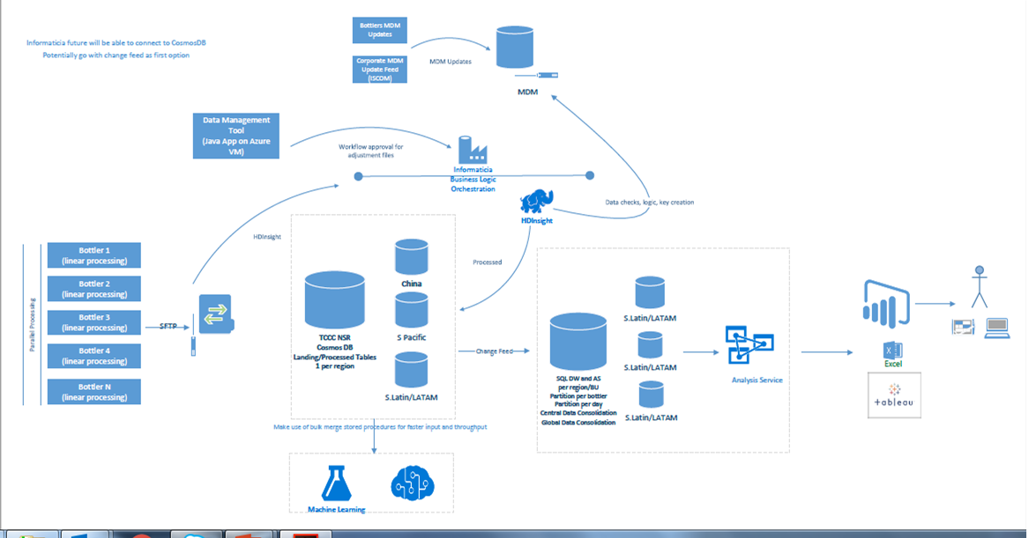
NSR Architecture
Internal Capgemini & Microsoft Confidential

Slide 4
HHP- The Coca-Cola team (TCCC) requested for a Proof of Concept for migration of the Existing Household Panel Application for Survey data for Households Globally in a short span of time to serve as an Model application for future migrations
BUSINESS / DATA CHALLENGES
SOLUTION
BENEFITS
Very short timeframe for Development
Build the model application to address performance issues in current On-Premise application plus serve as model application for future applications
Provide with Reporting Capabilities possible with the Current toolset as well as capabilities for Future Predictive Analytics
Enable a subscription based model to reduce the TCO for the customer
Product based approach to drive standardization
Fine grained security to ensure right access for the right user
Agile based development with 2 week sprints
Azure cloud based solution to support flexible subscriptions
Big Data based data lake to support scalability
Azure Databricks for Parallel processing capabilities for ETL and future capability for Predictive analytics
Cosmos DB and Azure SQL to support geo-distribution
Azure Data Factory, Logic Apps based standardized data processing
AAS – PowerBI based fine grained metrics to enable self-service
Reuse of existing SSIS packages using ADF SSIS Runtime
Rapid development of the solution in 5 weeks
Performance improvement Reduction in the data availability time from 8-10 hours to 2 hours
Cloud based subscription option
A model application framework to be used for future migrations
Data science capabilities for future use
Internal Capgemini & Microsoft Confidential

Slide 5
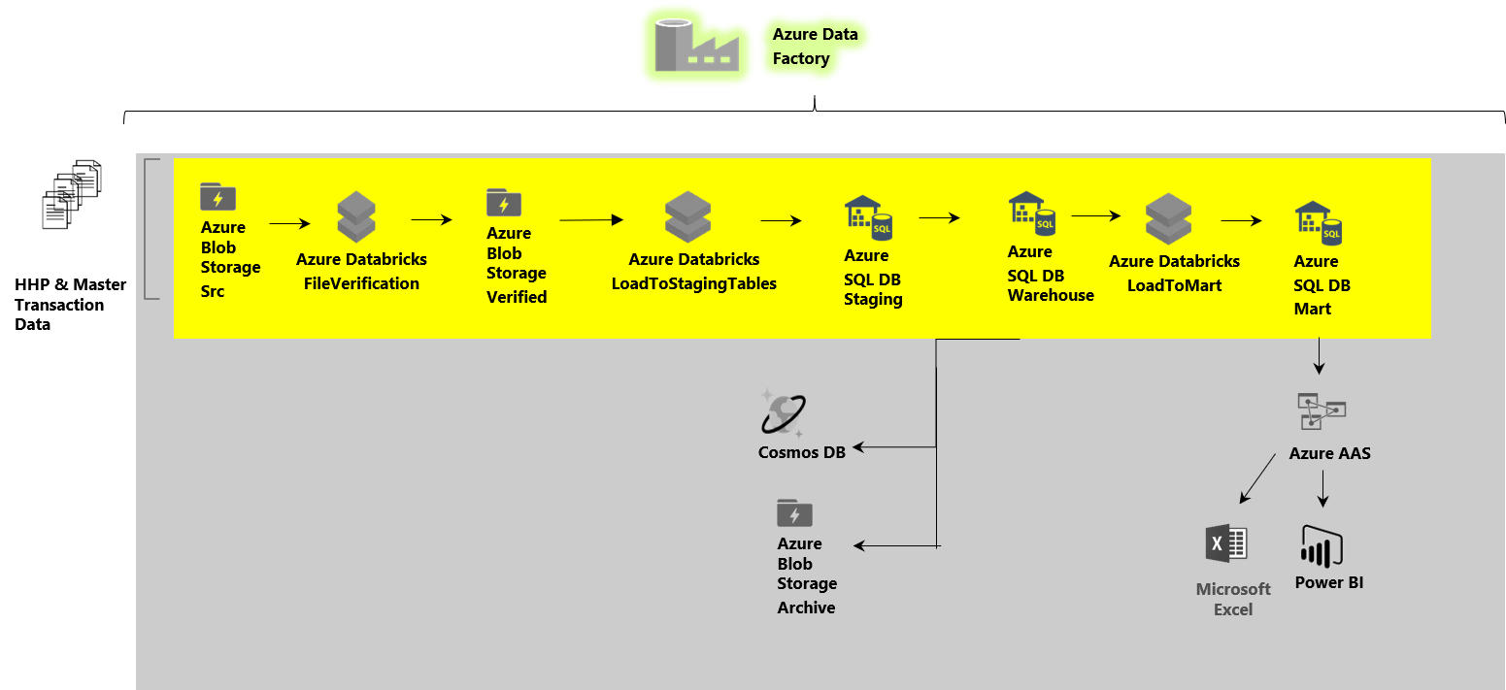
Global Household Panel Architecture
Internal Capgemini & Microsoft Confidential

